Slide 1
Metal Reactions

Slide 2
By the end of this lesson you should be able to:
Describe how selected metals react with oxygen.
Discuss how a metal’s reactivity with oxygen can determine how it is used.
Write equations to describe reactions between metals and water.
Describe the observations of selected metals when they react with water.
Write equations to describe reactions between metals and both dilute hydrochloric acid and sulfuric acid.

Slide 3
Metals can react with oxygen in two different ways, combustion and corrosion.
Corrosion occurs slowly when the metal is exposed to the oxygen in the air, forming a layer of metal oxide, also known as tarnishing.
Combustion occurs when the metal is heated. The heat energy speeds up the reaction between the metal and oxygen, and can produce heat and light in the reaction.
The basic word equation is the same for both kinds of reaction, the difference is just how quickly the reaction occurs.
metal + oxygen → metal oxide

Slide 4
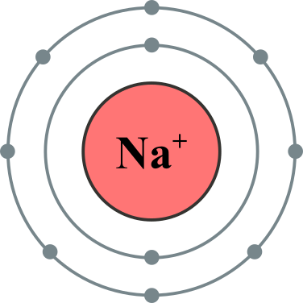
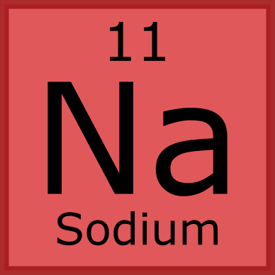
Metal ions that have a charge of +1 include lithium, sodium, potassium, and silver.
Oxide ions have a charge of −2, so two +1 metal ions are required to balance the charge of one oxide ion in order to create an electrically neutral compound.
The metal oxide formed will have the formula of M2​O (M represents the metal.)
For example, sodium reacts with oxygen to form sodium oxide:
sodium + oxygen → sodium oxide
4Na + O₂​ → 2Na_{2​}O

Slide 5
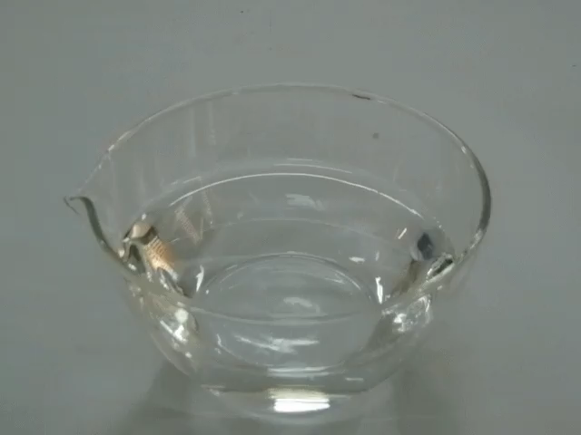

Metal and Water Reactions
Not all metals will react with water in the same way. Some metals react violently with water, producing metal hydroxide and hydrogen gas.
Others will only react with water in the form of steam, producing metal oxide and hydrogen gas. The most unreactive metals will not react with water at all.

Slide 6
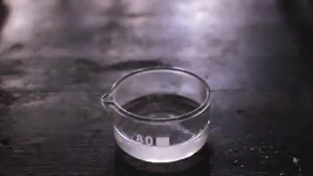
Metals react with cold water to produce a metal hydroxide and hydrogen gas. Only the most reactive metals such as alkali and alkaline earth metals will react with cold water.
metal + water → metal hydroxide + hydrogen gas

Slide 7
Sodium, potassium, and lithium ions all have a charge of +1. Hydroxide ions (OH−) have a charge of −1, which means that one hydroxide ion will balance the charge of one alkali metal ion to create an electrically neutral compound. The formula for this metal hydroxide is MOH.
For example, when sodium reacts with water it produces sodium hydroxide and hydrogen gas.
sodium + water → sodium hydroxide + hydrogen gas
2Na+2H₂​O→2NaOH+H₂​

Slide 8

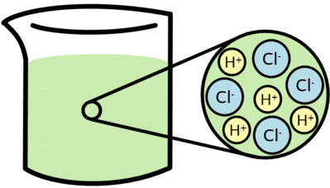
Metals react with hydrochloric acid to produce a metal chloride and hydrogen gas. The basic word equation for this reaction is:
metal + hydrochloric acid → metal chloride + hydrogen gas
Chloride ions have a −1 charge, and the formula of the metal chloride will be different depending on the charge of the metal cation.

Slide 9
For metal ions with a +1 charge, one chloride ion will balance the charge of the metal ion and the metal chloride will have the formula MCl. For example:
2Na+2HCl→2NaCl+H₂​
For metal ions with a +2 charge, two chloride ions are required to balance the charge of one metal ion and the metal chloride will have the formula MCl_{2​}. For example:
Ca+2HCl→CaCl₂​+H₂​
For metal ions with a +3 charge, three chloride ions are required to balance the charge of one metal ion and the metal chloride will have the formula MCl₃​. For example:
2Al+6HCl→2AlCl₃​+3H₂​

Slide 10

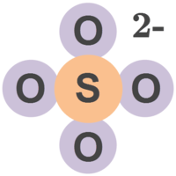
Metals react with sulfuric acid to produce a metal sulfate and hydrogen gas. The basic word equation for this reaction is:
metal + sulfuric acid → metal sulfate + hydrogen gas
Sulfate ions (SO₄^{​2−}) have a −2 charge, and the formula of the metal sulfate will be different depending on the charge of the metal cation.

Slide 11
